Slide 1
Compiler Design
Department of Computer Science
Syntax Analysis

Slide 2
Syntax Analysis
The syntax analyzer (parser) checks whether a given source program satisfies the rules implied by a context-free grammar or not.
If it satisfies, the parser creates the parser tree of that program
Otherwise the parser gives the error messages.

Slide 3
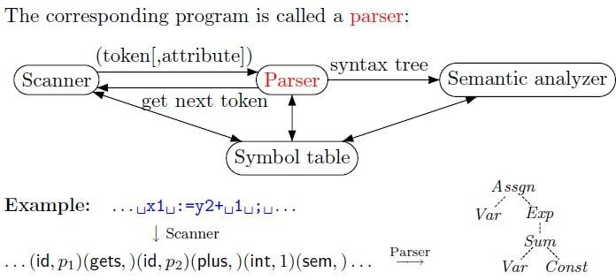
The syntax of a programming is described by a context-free grammar (CFG). We will use BNF (Backus-Naur Form) notation in the description of CFGs.
Languages that are generated by context-free grammars are context-free languages.

Slide 4

Context-free grammars are more expressive than finite automata: if a language L is accepted by a finite automata then L can be generated by a context-free grammar
Beware: The converse is NOT true
Context-Free Grammar (CFG)
A grammar consists of 4 components (T, N, s, )
T — set of terminal symbols
Essentially tokens — those appear in the input string
N — set of non-terminal symbols
Categories of strings impose hierarchical language structure
Useful for analysis

Slide 5
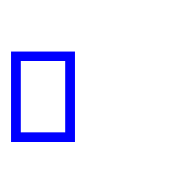
example: declaration, statement, loop, ...
s — a special non-terminal start symbol that denotes
every sentence is derivable from it
— a set of production rules
―LHS → RHS‖: left-hand-side produces right-hand-side
Each production rule in context-free grammar must be of the form:
A → α
where A represents a single non-terminal and α is any string of terminals and non-terminals.
A context-free grammar

Slide 6
Gives a precise syntactic specification of a programming language.
A grammar can be directly converted into a parser by some tools.
Example 1
Grammar: G = { N, T, S, P }; N = { S, A, B }; T = { a, b, d }; S = { S }
P (Production Rules) :
S -> a A B d A -> b

Slide 7
B -> a.
String: abad.
Solution: S -> a A B d a b B d
a b a d.
This is equal to given string.
Accept.
Example 2
Grammar: = {N, T, S, P }; N = { E }; T = { +, -, *, /, (, ), id };
P: E -> E+E / E-E / E*E / E/E / (E) / id.
a. String: id + id.
Solution: E -> E + E
S = { E }

Slide 8


id +E id + id.
Accept.
b. String: ( id + id ).
Solution: E -> ( E )
( E + E )
( id + E )
( id + id ).
Accept.
Example 3
Grammar: G = { N, T, S, P }; over the alphabet {a,b}.
P (Production Rules) : S -> aSb | ε

Slide 9
Generate the context-free (and non-regular) language. L = {a^{n}b^{n} | n>=0}.
The example derivation
S → aSb → aaSbb → aabb.
Derivation
Derivation is a sequence of replacements by using production rules from the starting symbols to get a given string.
There are two types:

Slide 10
a. Leftmost derivation: Left-most derivations are those in which the leftmost non-terminal is replaced at each step of
derivation.
b. Rightmost derivation: Rightmost derivations are those in which the rightmost non-terminal is replaced at each step. It is also called “canonical derivations”.
Example:
– Grammar: G = { N, T, S, P }; N = { E }; T = { +, -, *,
/, (, ), id }; S = { E }
– P: E -> E+E | E-E | E*E | E/E | (E) | id.
Find the leftmost derivations and rightmost derivations of the following string: (( id + id ) * id / id ).
Solution:

Slide 11
E → (E) → ( E * E ) →( ( E ) * E ) → ( ( E + E ) * E ) → ( ( id + E )
* E ) → ( ( id + id ) * E ) → ( ( id + id ) * E / E ) → ( ( id + id ) * id /
E ) → ( ( id + id ) * id / id ). Leftmost Derivation
E → (E) → ( E / E ) → ( E / id ) → ( E * E / id )→ ( E * id / id ) → ( ( E ) * id / id ) → ( ( E + E ) * id / id ) → ( ( E + id ) * id / id ) → ( ( id + id ) * id / id ). Rightmost Derivation
Exercise
1. Show a left-most derivation for each of the following strings, using the given grammar.
Expr → Expr + Expr | Expr Expr | ( Expr ) | var | const
(a) var + const (b) var + var var

Slide 12
(c) (var)
Solution:
(d) ( var + var ) var
Expr → Expr + Expr
→ var + Expr
→ var + var
Expr → Expr * Expr
→ Expr + Expr * Expr
→ var + Expr * Expr
→ var + var * Expr
→ var + var * var
(b)
Parse Trees
A labeled tree in which:
– the interior nodes are labeled by non-terminals

Slide 13
leaf nodes are labeled by terminals
the children of an interior node represent a replacement of the associated nonterminal in a derivation
corresponding to a derivation
What is the relationship between a parse-tree and derivations?
– Parse tree is the graphical representation of derivations
– many-to-one relationship between derivations and parse-tree.

Slide 14
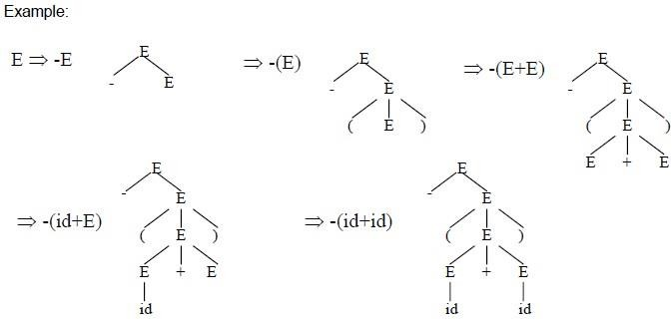
Example
Parse tree for the expression: ((id + id) * id / id) of the previous example.

Slide 15
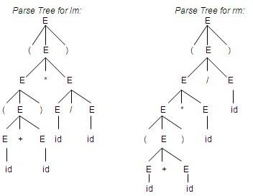
Solution: Parse tree for two types of derivations, such as leftmost (lm) derivation and right-most (rm) derivation.

Slide 16
Ambiguous Grammars
A grammar that produces more than one left-most (or) rightmost derivation for some string (sentence) is called
ambiguous grammar.
For the most parsers, the grammar must be unambiguous.
Unambiguous grammar:
– Unique selection of the parse tree for a sentence.
We should eliminate the ambiguity in the grammar during the design phase of the compiler.
An unambiguous grammar should be written to eliminate the ambiguity.

Slide 17
Ambiguous Grammars
We have to prefer one of the parse trees of a sentence (generated by an ambiguous grammar) to disambiguate that grammar to restrict to this choice.)
Ambiguous grammars (because of ambiguous operator) can be disambiguated according to the precedence and associativity rules.

Slide 18
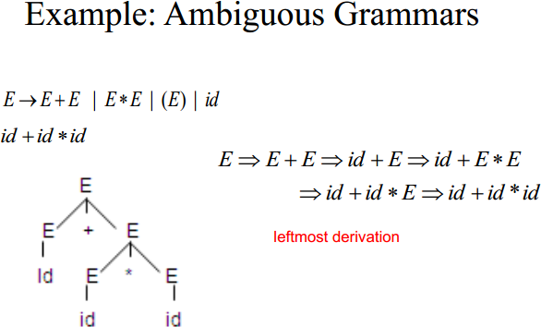

Slide 19
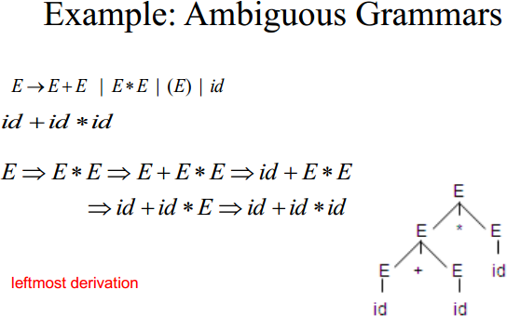

Slide 20
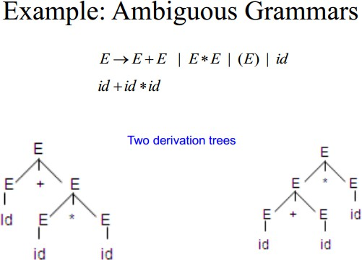

Slide 21
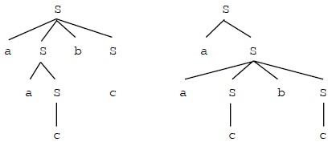
Exercise
1. Determine whether the following grammar is ambiguous. If so, show two different derivation trees for the same string of terminals, and show a left-most derivation corresponding to each tree.
S → aSbS | aS | c • Solution:
S → aSbS
→ aaSbS
→ aacbS
→ aacbc
S → aS
→ aaSbS
→ aacbS
→ aacbc

Slide 22
Parser
Parsing is the activity of checking whether a given string of symbols (usually, the stream of tokens produced by a lexical analyser) is in the language of some grammar, and if so, constructing a parse tree for it.
Two general types (methods) of parsers:
Top-down methods
Bottom-up methods
These terms refer to the order in which nodes in the parse tree are constructed.

Slide 23
Top-down Parsing
Parse-trees built from root to leaves.
Input to parser scanned from left to right one symbol at a time.
top-down parsing method is called ―recursive descent‖ parsing.
predictive parser is one kind of recursive descent parser.
Also called as LL parsing:
L means that tokens are read left to right.
L means that it constructs a leftmost derivation.

Slide 24
The popularity of top-down parsers is due to the fact that
efficient parsers can be constructed more easily by hand using top-down methods.
Bottom-Up Parsing
Start from leaves and work their way up to the root.
Input to parser scanned from left to right one symbol at a time.
bottom-up parsing method is called ― shift-reduce (SR)‖ parsing.
An operator-precedence parser is one kind of shift-reduce parser.
Also called as LR parsing:

Slide 25
L means that tokens are read left to right.
R means that it constructs a rightmost derivation.
Bottom-up parsing, however, can handle a larger class of grammars and translation schemes, so software tools for generating parsers directly from grammars often use bottom-up methods.
Example

Slide 26
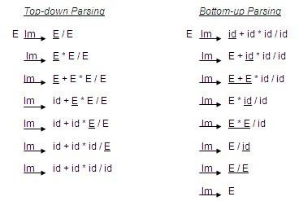
•

Slide 27

Example
Grammar for a fragment of a programming language:
Suppose try to parse
we
the statement:

Slide 28
Top-down parsing
Stmt → if cond then stmt
→ if var == var then stmt
→ if var == var then var=var
Bottom-Up parsing
Stmt → if var == var then var=var
→ if var == var then stmt
→ if cond then stmt
→ stmt
Shift-Reduce (SR) Parsing
A shift-reduce parser tries to reduce the given input string into the starting symbol.
At each reduction step, a substring of the input matching to the right side of a production rule is replaced by the non-terminal at the left side of that production rule.

Slide 29
If the substring is chosen correctly, the right most derivation of that string is created in the reverse order.
Example: Grammar S → aABb; A → aA | a; B → bB | b; and the input string is aaabb.
– aaabb → aaAbb → aAbb → aABb → S
Shift-Reduce (SR) Parsing
Handle: a handle of a string is a substring that matches the right side of a production rule.
Reduction: The process of ―reducing‖ a string ‗w‘ to the start symbol of grammar. At each replacement of the right side of a production by the left side in the process is called a
―reduction‖.

Slide 30
Handle Pruning: A rightmost derivation in reverse, often called a “canonical reduction sequence”, is obtained by
“handle pruning”.
SR Parsing: Example
Example: Consider the following grammar :
1. E -> E + E, 2. E -> E * E 3. E -> ( E ), 4. E -> id,
and the input string id1 + id2 + id3. The following sequence of reductions reduces id1 + id2 + id3 to the start symbol E:

Slide 31
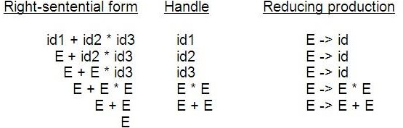
Stack Implementation of Shift-Reduce Parsing
A convenient way to implement a shift-reduce parser is to use a
stack and an input buffer.
There are four possible actions of a shift-parser action:

Slide 32
Shift: The next input symbol is shifted onto the top of the stack.
Reduce: Replace the handle on the top of the stack by nonterminal.
Accept: Successful completion of parsing.
Error: Parser discovers a syntax error, and calls an error recovery routine.
Initial stack just contains only the end-marker $.
The end of the input string is marked by the end-marker $.
Stack Implementation of SR-Parsing: Example
Consider the previous grammar and derivation.

Slide 33
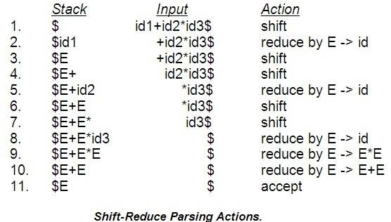

Slide 34
Stack Implementation of Shift-Reduce Parsing
There are four steps to be followed for Shift-Reduce Parsing method:
Find the right-most derivation.
Prepare the handle list – Implement the stack
Construction of parse tree.

Slide 35
Operator-Precedence Parsing
A grammar is said to be a operator grammar, if all the productions containing no two consecutive non-terminal nodes in the right hand side.
Example:
1: E -> id; E -> E + E; E -> E * E; E -> (E). [ Valid ]
2: E -> E OP E [ In-valid, because two consecutive capital letters placed ]
S -> AbB [ Valid ] A -
> aBb [ Valid ]

Slide 36
3: S -> aABc.
letters placed ].
[ In-valid, because two consecutive capital
L-R (Left-to-Right) Parsing
LR parser consists of two parts: a driver routine and a parsing table.
The driver routine is the same for all LR parsers; only the parsing table changes from one parser to another.
The schematic form of LR parser is:

Slide 37
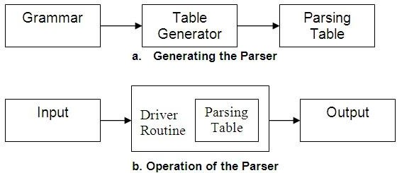
L-R (Left-to-Right) Parsing
There are three different techniques for producing LR parsing tables.
1. Simple LR (SLR): This method is easiest to implement. Unfortunately, it may fail to produce a table for certain grammars on which the other method succeed.

Slide 38
2. Canonical LR (CLR): This is the most powerful and will work on a very large class of grammars. Unfortunately this method can be very expensive to implement.
Look-Ahead LR (LALR): This is intermediate in power between the SLR and the canonical LR methods. This method will work on most programming language grammars and, with some effort, can be implement efficiently.
Push-down Automata/Machine (PDA)
Push-down Automaton (PDA) is a nondeterministic finite automaton equipped with an additional storage device called a

Slide 39
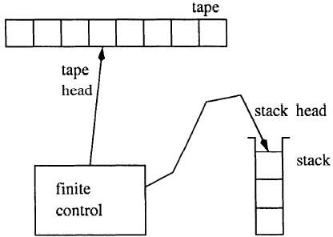
stack, and a stack head which reads from and writes to the top of the stack.

Slide 40
Push-down Automata/Machine (PDA)
The stack is a first-in last-out storage device with no predetermined size limit.
The stack head always scans the top element of the stack.
It performs two basic stack operations:
Push: add a new symbol at the top of the stack.
Pop: read and remove the top symbol from the stack.
PDA are equivalent in power to context-free grammars.
PDA is a recognizes strings given in a context-free grammar.

Slide 41
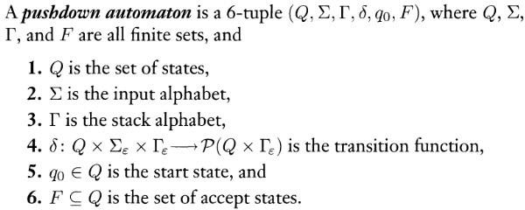
Formal Definition of PDA

Slide 42
How PDA computes
At the beginning:
a PDA is in the initial state q0,
The PDA have an empty stack, and
Its tape head is scanning the leftmost symbol of the input tape.
At the end, we say a PDA accepts the input if, in one of its computation paths, it reads all input symbols, has an empty stack, and reaches a final state.

Slide 43
Error Recovery Techniques
Panic-Mode Error Recovery
Skipping the input symbols until a synchronizing token is found.
Phrase-Level Error Recovery
Each empty entry in the parsing table is filled with a pointer to a specific error routine to take care that error case.
Error-Productions
If we have a good idea of the common errors that might be encountered, we can augment the grammar with productions that generate erroneous constructs.
When an error production is used by the parser, we can generate appropriate error diagnostics.
Since it is almost impossible to know all the errors that can be made by the programmers, this method is not practical.
Global-Correction
Ideally, we we would like a compiler to make as few change as possible in processing incorrect inputs.

Slide 44
We have to globally analyze the input to find the error.
This is an expensive method, and it is not in practice.
Panic-Mode Error Recovery in LL(1) Parsing
In panic-mode error recovery, we skip all the input symbols until a synchronizing token is found.
What is the synchronizing token?
– All the terminal-symbols in the follow set of a non-terminal can be used as a synchronizing token set for that non-terminal.
So, a simple panic-mode error recovery for the LL(1) parsing:

Slide 45
All the empty entries are marked as synch to indicate that the parser will skip all the input symbols until a symbol in the follow set of the non-terminal A which on the top of the stack. Then the parser will pop that non-terminal A from the stack. The parsing continues from that state.
To handle unmatched terminal symbols, the parser pops that unmatched terminal symbol from the stack and it issues an error message saying that that unmatched terminal is inserted.

Slide 46
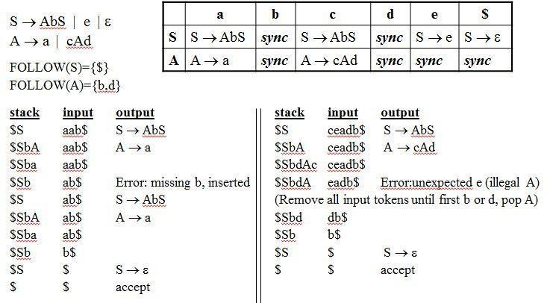
Panic-Mode Error Recovery - Example

